Slide 1


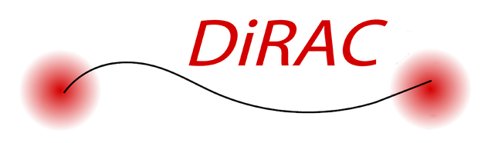

3D models for the multiphase wind of M82
Yuxuan Yuan (IoA, Cambridge)
Mark Krumholz (ANU)
Crystal Martin(UCSB)

Slide 2
Outline
Introduction
What are galactic winds/why are they important?
Previous methods. Limitations?
How we do better
Higher quality data
State-of-the-art model
Results
Good fits between model and data
Tight constraint on the physical properties
Further implications
Summary

Slide 3
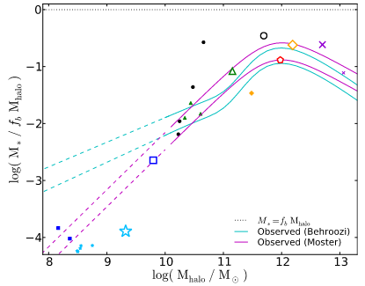
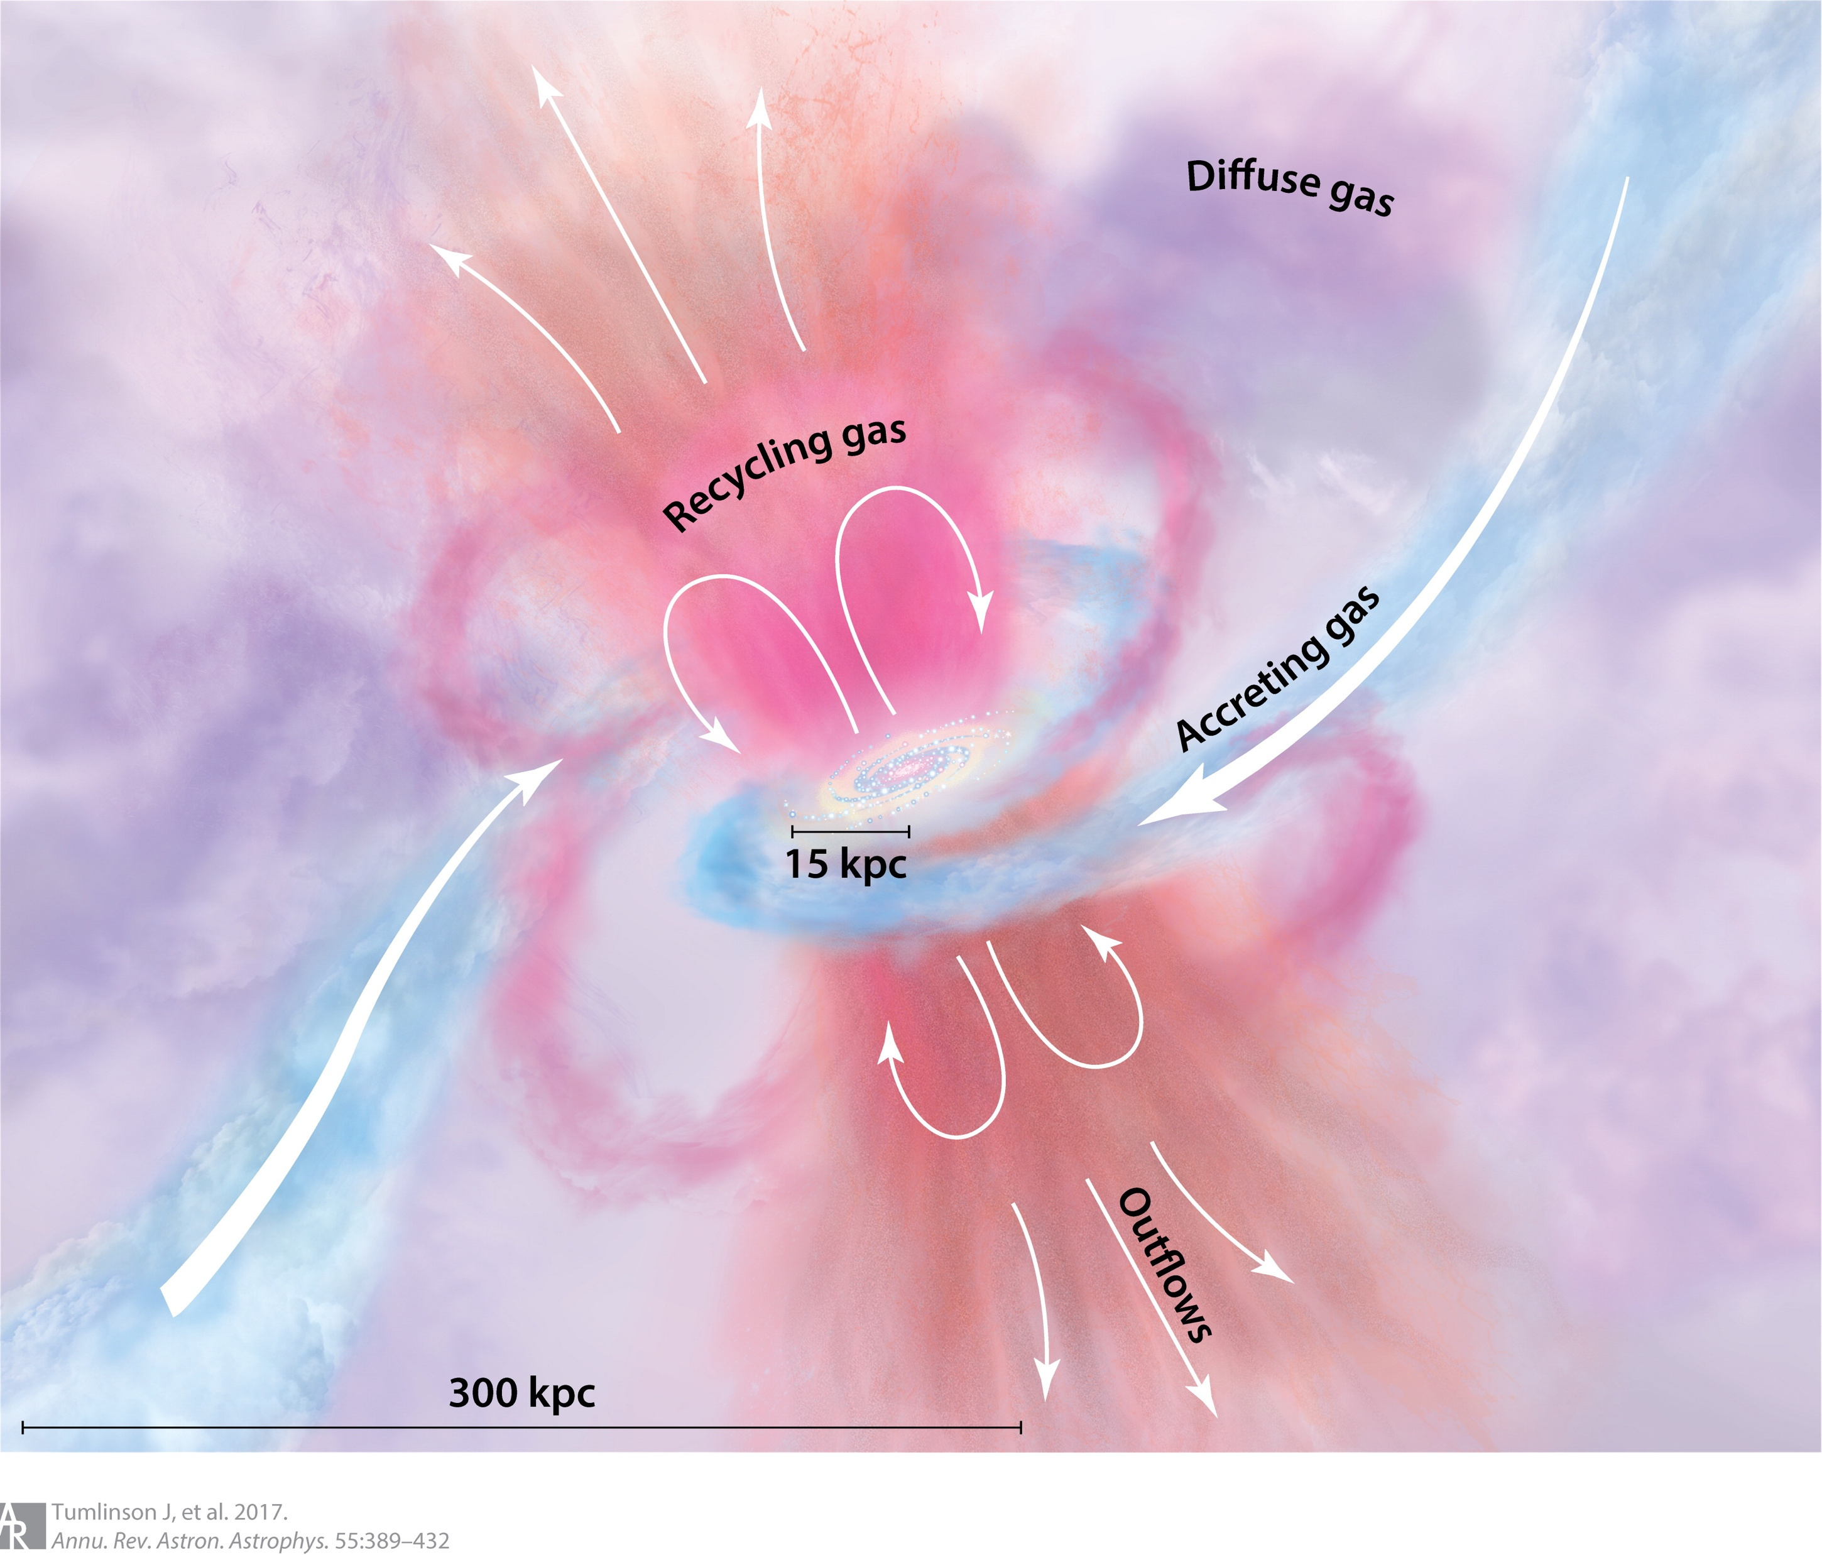
winds
Winds: Streams of high-velocity clouds
Generated by SN, radiation or AGN
Multiphase structure
Large impact
Galactic scale: quench star formation; control the baryonic budget of galaxies.
Cosmological scale: transport mass to CGM or IGM.
Hopkins+14
Tumlinson+17

Slide 4
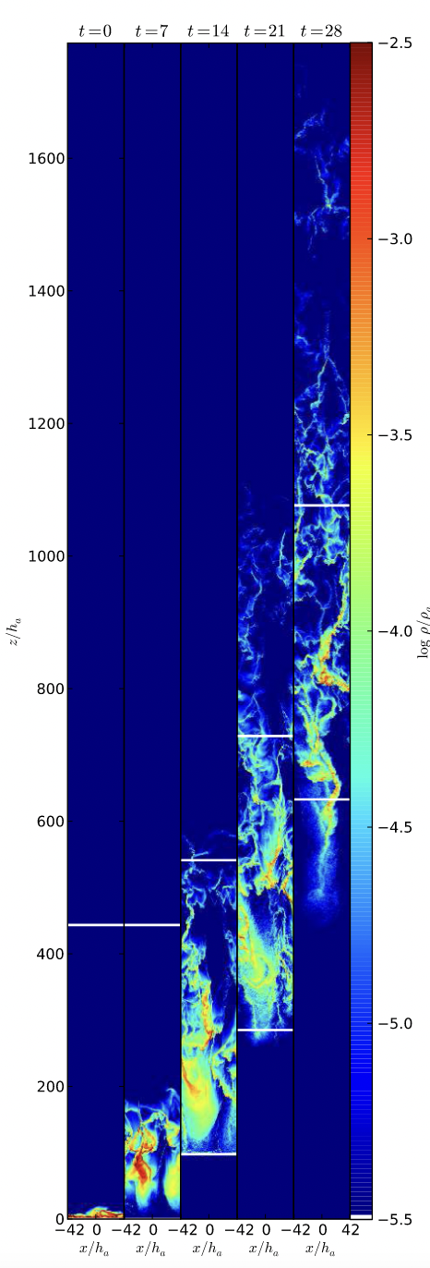
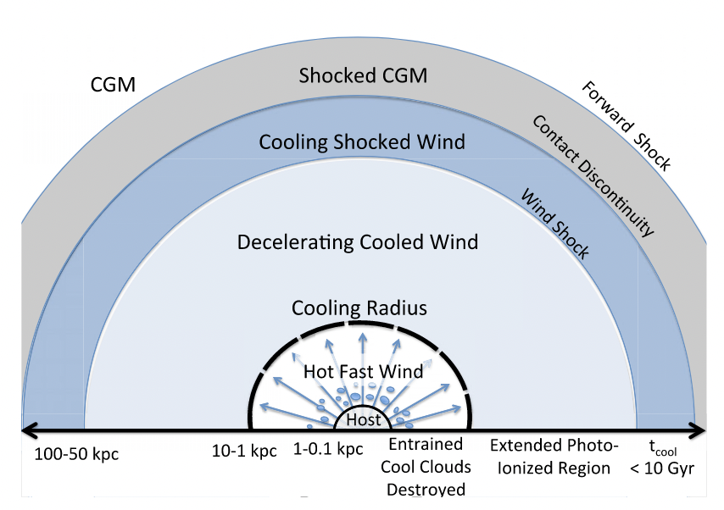
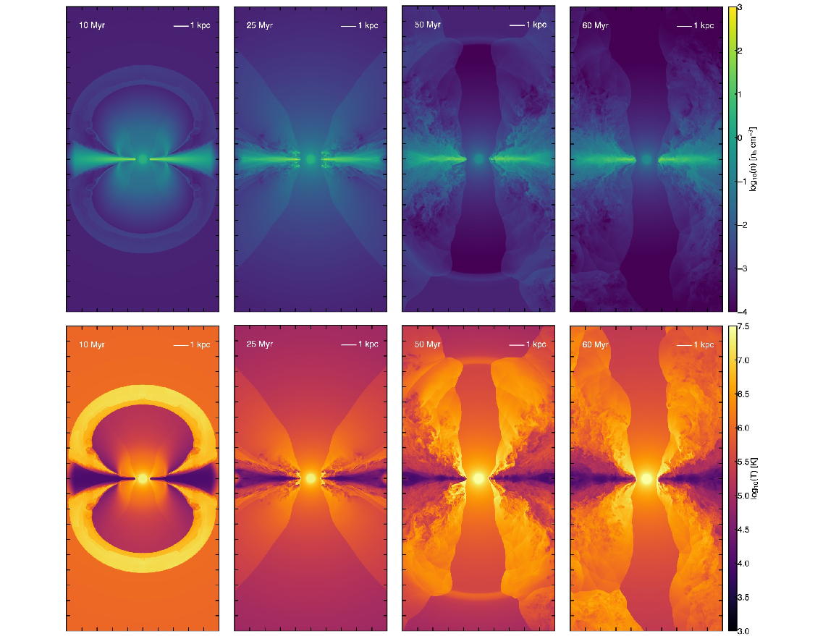
Wind scenarios
Hot wind (Chevalier&Clegg 1985)
Shock heated gas from SN
Cool wind
Radiative cooling
Hot wind entrainment
Radiation pressure or CR
Thompson+16
Schneider+18
Krumholz&Thompson13

Slide 5
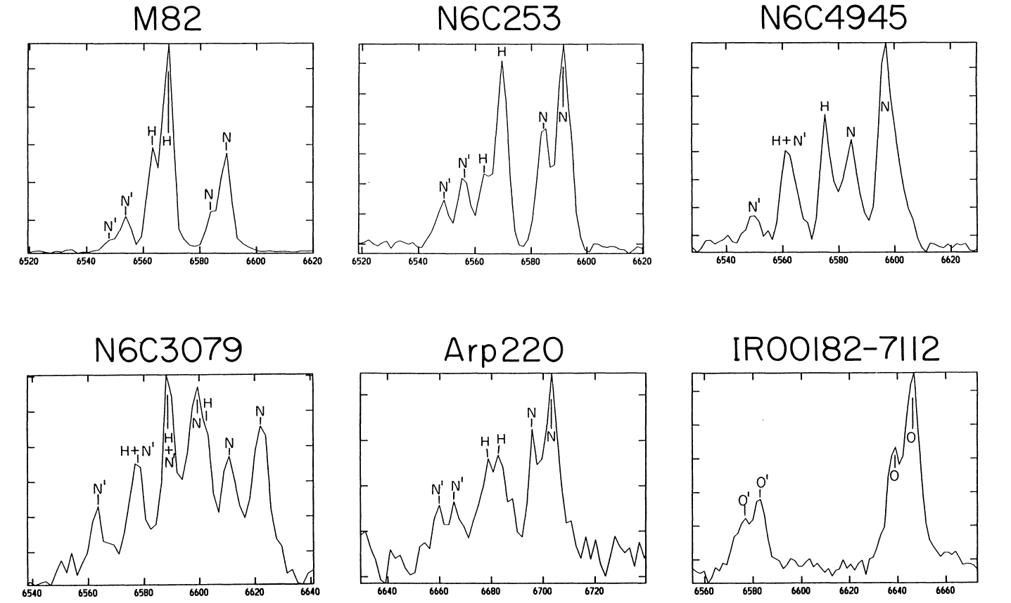
Extract information from observations
Direct extraction
Emission -> kinematics (conversion factor)
Double-peaked profile -> biconical sheath geometry
Heckman et al 1990 N’: [NII] $λ6548$, H: H$α$, N: [NII] $λ6584$

Slide 6
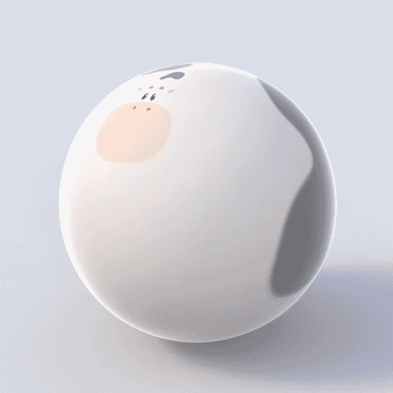
Extract information from observations
Numerical simulations -> too expensive!
Analytical wind model -> parameter fitting (Steidel+10 Lochhaas+18)
“Spherical cow model”
Simplified wind structure
Un-resolved, stacked spectra
Single phase

Slide 7
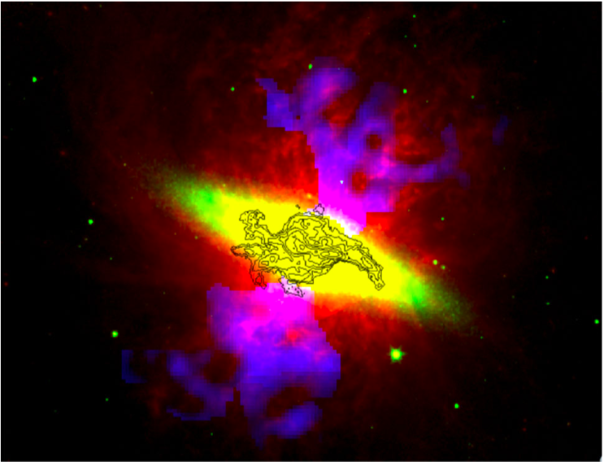

Rich data of winds in M82
A nearby (3.6 Mpc) edge-on dwarf galaxy
Merger-driven intense starburst, SFR = 4.1 $M_{⊙}$/yr
Emission over the entire position-position-velocity space for various species
Veilleux et al 2020

Slide 8
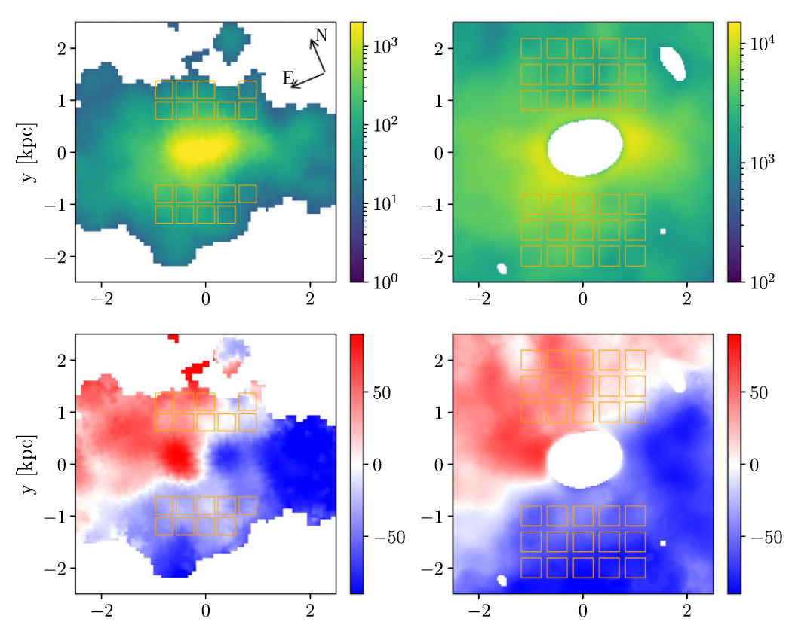
Wide-field map
CO 2->1 Leroy+2015
HI 21 cm
Martini+2018
Rotation disc structure below ±0.8 kpc
Select wind spectra above this height (shown by orange squares)
Velocity integrated intensity
Mean velocity of spectra
x [kpc]
x [kpc]

Slide 9

Our wind model DESPOTIC
Krumholz14, Krumholz+17
Mechanism: winds are composed of a population of momentum-driven gas clouds from an isothermal turbulent medium.
Physical parameters and prescriptions:
Driving mechanism for clouds:
Ideal (constant $\dot{p}$), radiation driven ($τ$), hot wind entrainment ($u_{h}$)
Gravitational potential: point source, isothermal sphere
Cloud’s expansion law: constant area, intermediate, constant solid angle
constant area intermediate constant solid angle

Slide 10

Free parameters:
The Mach number of the turbulent ISM
Orientation $φ$, opening angle $θ_{in},$ $θ_{out}$
Mass outflow rate ${\dot{M}}_{w}$

Slide 11
Why can our DESPOTIC model improve the previous measurement
Reasonable balance between physical complexity and numerical efficiency.
Capable of describing spatially resolved multi-wavelength data.
Joint study of multiple phases of the wind (molecular and atomic) in one theoretical framework.

Slide 12

Warm neutral outflow (HI 21cm)
Launched clouds are ideally driven from a point potential and maintain constant cross-sectional area.
Fitted parameter (for one hemisphere):
$φ={4.73}^{∘}, θ_{in}={30.08}^{∘}, θ_{out}={85.96}^{∘}, \dot{M}={4.0}_{−1.0}^{+1.6}\frac{M_{⊙}}{yr}, \log{ℳ} ≳1.57$
Mass loading factor: $η=\frac{\dot{M}}{{\dot{M}}_{∗}}=0.98$

Slide 13
Warm neutral outflow (HI 21cm)
Grey band: HI 21 cm spectra for one hemisphere at 15 different positions.
Blue: best fit
Yellow: fits from 10 MCMC walkers in the last iteration.

Slide 14
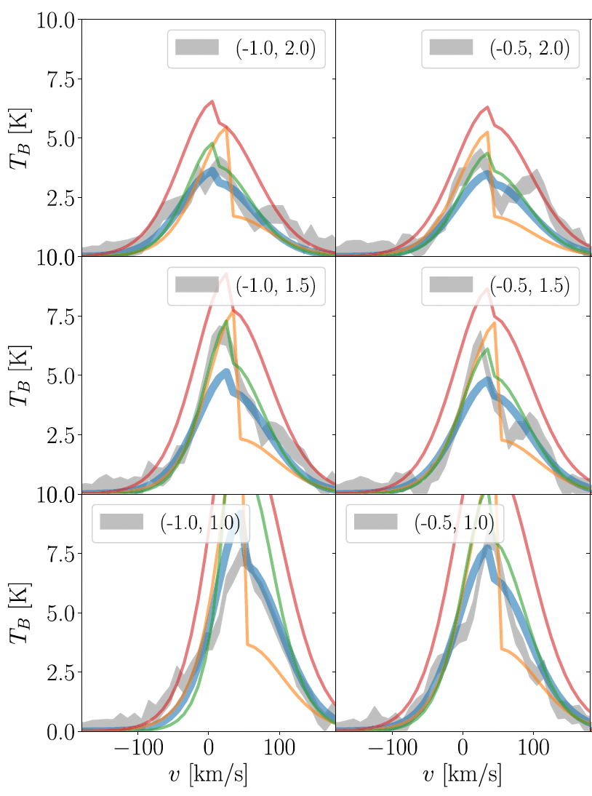
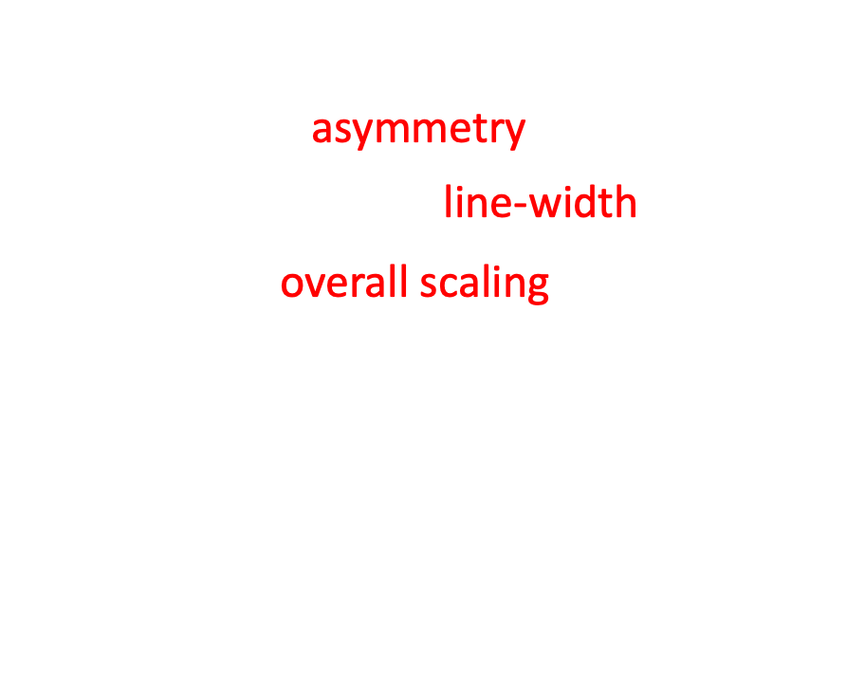
Variations with the parameters
Yellow: $φ$ -> asymmetry
Green: $θ_{in}$, $θ_{out}$ -> line-width
Red: $\dot{M}$ -> overall scaling.
Our model is able to capture the rich information hidden in the spectra.

Slide 15
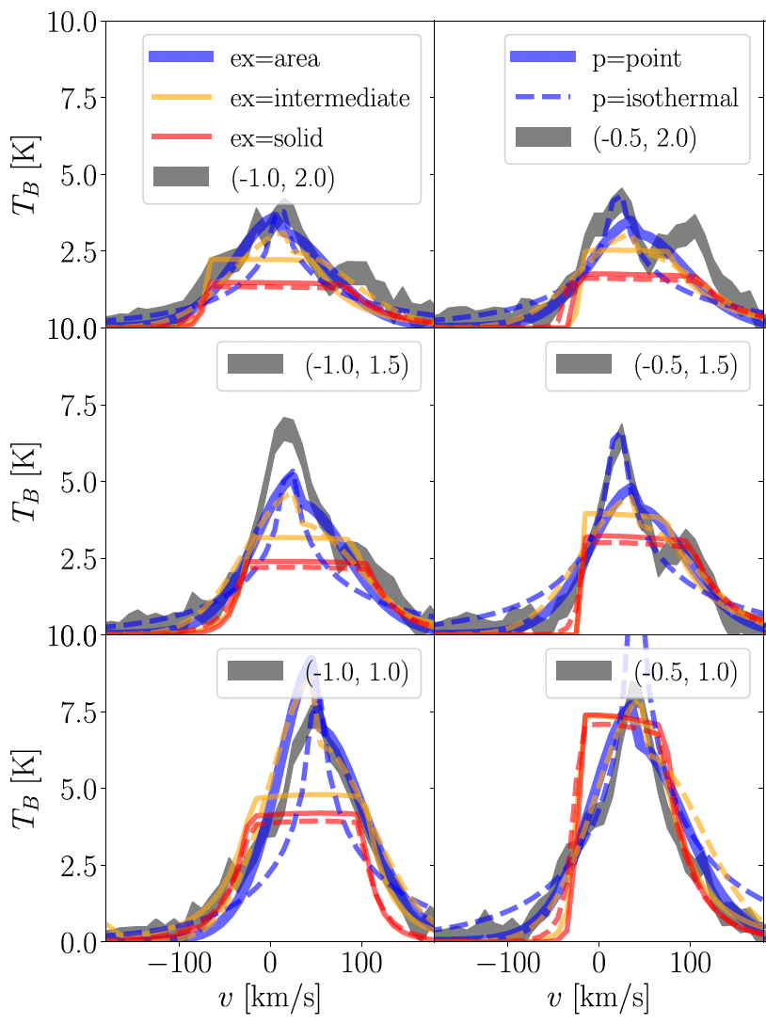
Variation with Potential and Expansion law
Effect of gravitational potential and cloud expansion law on spectral shape

Slide 16

Cold molecular outflow (CO 2->1)
Clouds are ideally driven from a point potential and maintain constant cross-sectional area.
$φ={−3.16}^{∘}, θ_{in}={11.34}^{∘}, θ_{out}={80.87}^{∘}, \dot{M}={2.0}_{−0.65}^{+1.1}\frac{M_{⊙}}{yr}, \log{ℳ}=0.83$
$η=\frac{\dot{M}}{{\dot{M}}_{∗}}=0.49$

Slide 17
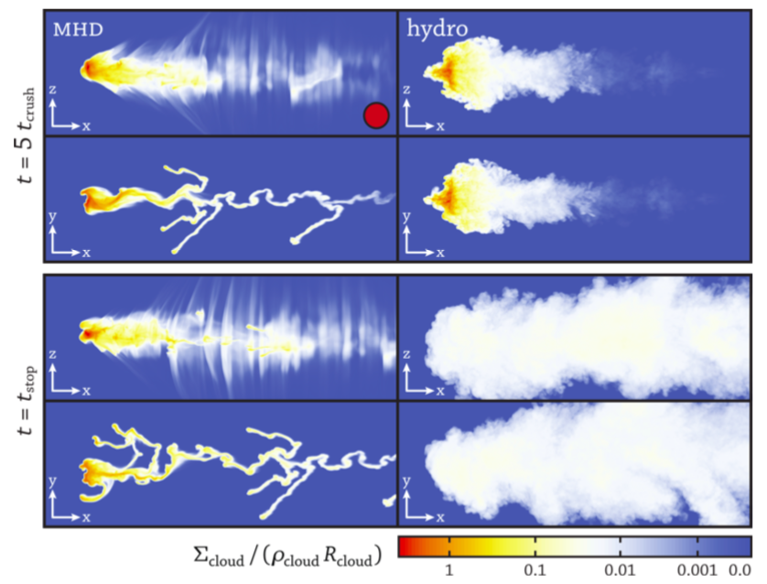
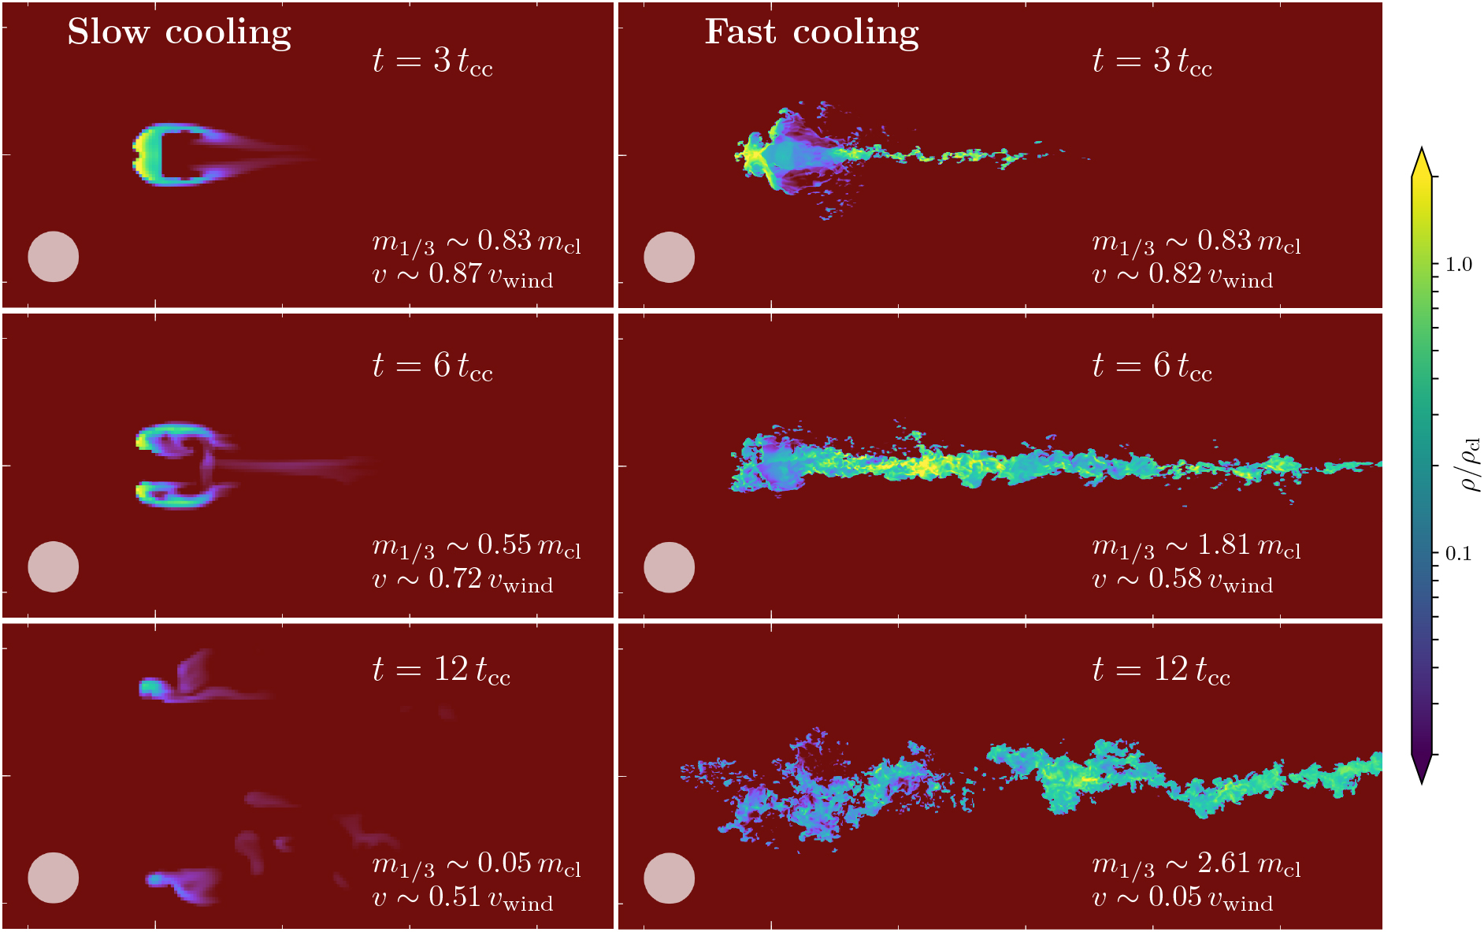
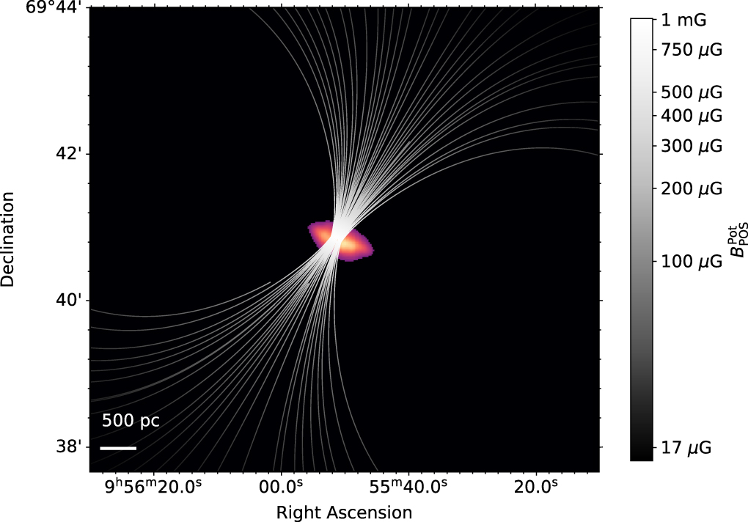
Implications From Best fits for magnetic field and cooling
For both warm neutral and cold molecular outflow:
The entrained cool clouds maintain their constant cross-sectional area.
B and cooling could confine the cloud expansion.
McCourt+15
Gronke&Oh 18
Lopez-Rodriguez+21

Slide 18

Summary
The wind has an edge-on orientation and a conical sheath geometry for all phases, consistent with earlier visual analyses.
The total mass flux carried by the warm neutral phase is ≈8 $\frac{M_{⊙}}{yr}$ , while that carried by the molecular phase is ≈2 $\frac{M_{⊙}}{yr}$ . The latter is uncertain at the factor of ≈2 level, while the former is tightly constrained, with only ≈25 per cent uncertainty.
The atomic and molecular clouds retain near constant area as they flow outward, rather than expanding to intercept more momentum.
For further details, please refer to https://arxiv.org/abs/2204.05006

Slide 19
Thanks!

